Slide 1
ODI TRAINING - BASICS
December 9th, 2019

Slide 2
Meeting Agenda
Agenda
What is ODI?
ETL vs E-LT
ODI Components: Overview
ODI Architecture
ODI Repositories
ODI Studio Components
Topology Navigator
What is a Data-Server?
Security Navigator
What is an Agent?
What is a Context?
Questions

Slide 3
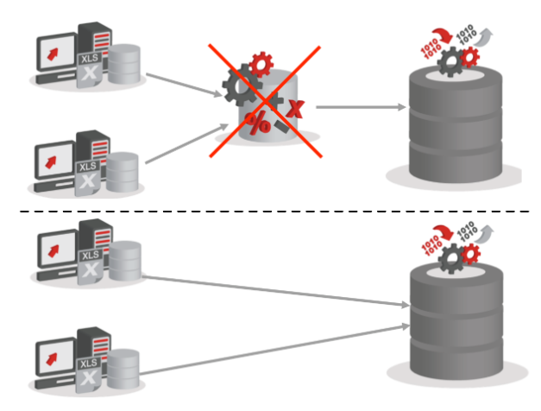
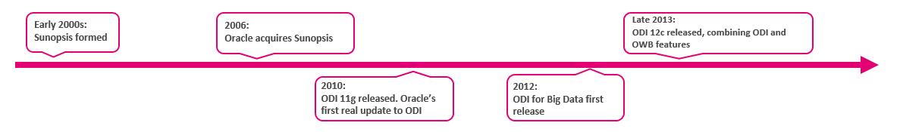
What is ODI?
Heterogeneous sources and targets
Built to integrate all data
Flexibility
ODI will adapt to your data warehouse –and not the other way around
Reusable code templates(Knowledge Modules)
Unique E-LT (Extract - Load Transform) architecture
Flow based mappings
Data quality firewall
Better execution performance
Data Connectivity
Cost-savings

Slide 4
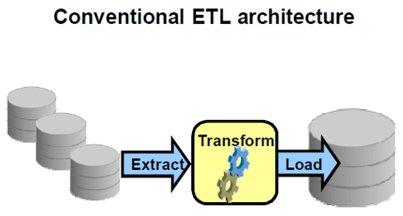
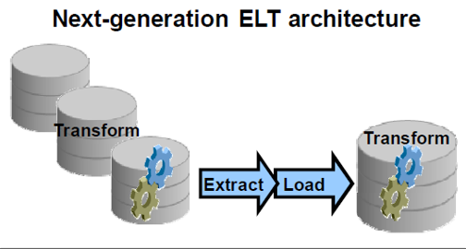
ETL vs E-LT
Description
Extract: Extracting data from various sources
Load: Loading the data into the destination target
Transform: Transforming the data according to a set of business rules

Slide 5
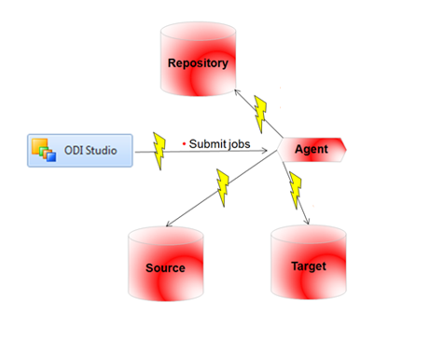
ODI Components
ODI Studio Components:
– Designer Navigator
– Operator Navigator
– Topology Navigator
– Security Navigator
ODI agents
ODI Console
ODI repositories

Slide 6
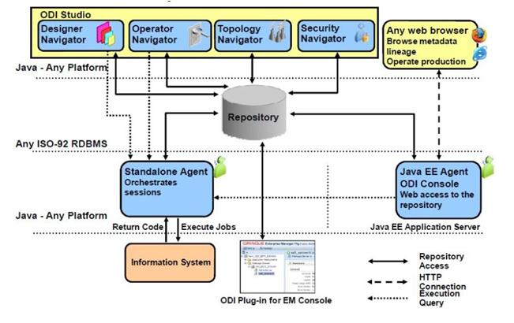
ODI 12C Architecture and Components

Slide 7
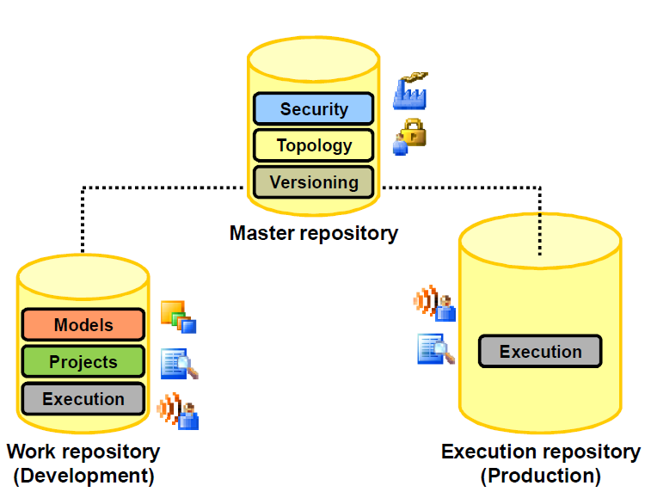
Master and Work Repositories - Part I
Master Repository: It is the data structure containing information about the topology of the company’s IT resources, security, and version management of projects and data models.
Work Repository: It is the data structure containing information about data models, projects, and their use.

Slide 8
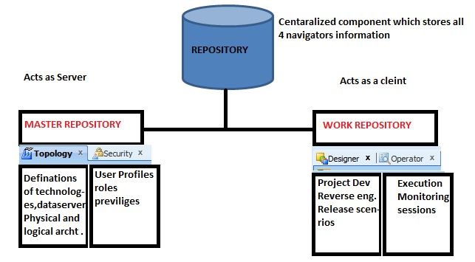
Master and Work Repositories - Part II

Slide 9
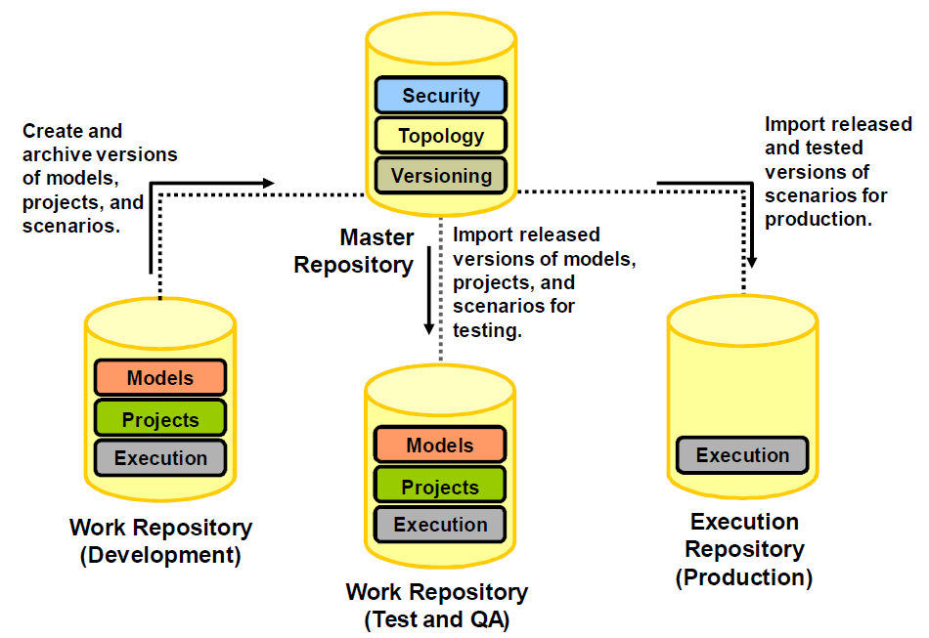
Repository Setup: Example

Slide 10
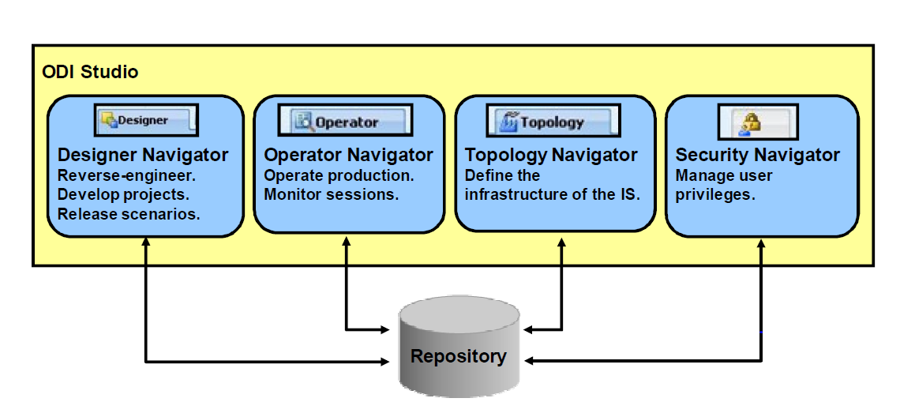
ODI STUDIO

Slide 11
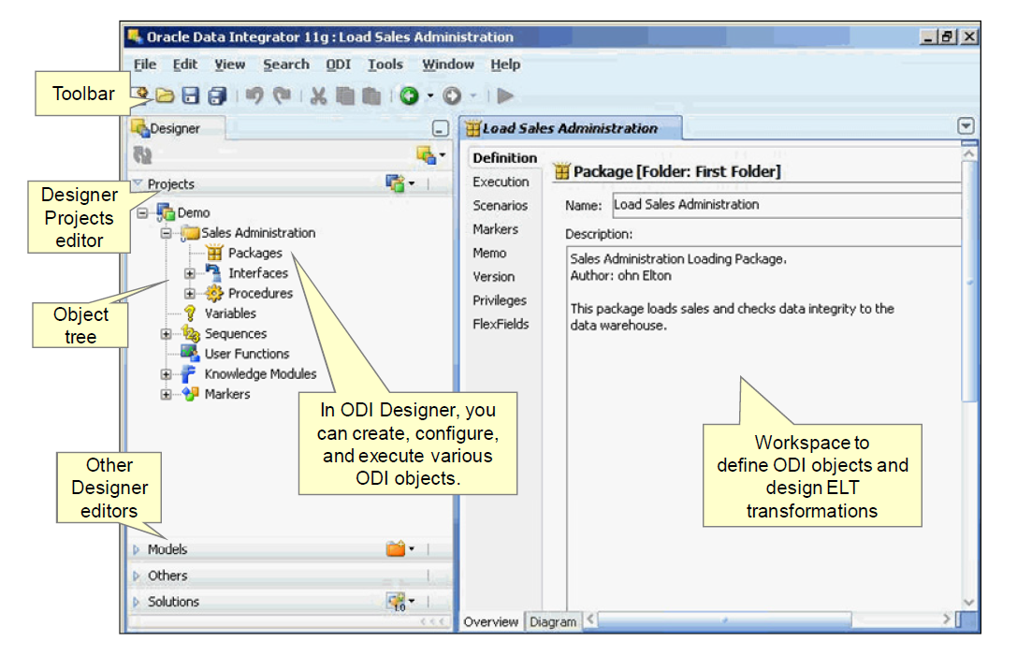
Designer Navigator

Slide 12
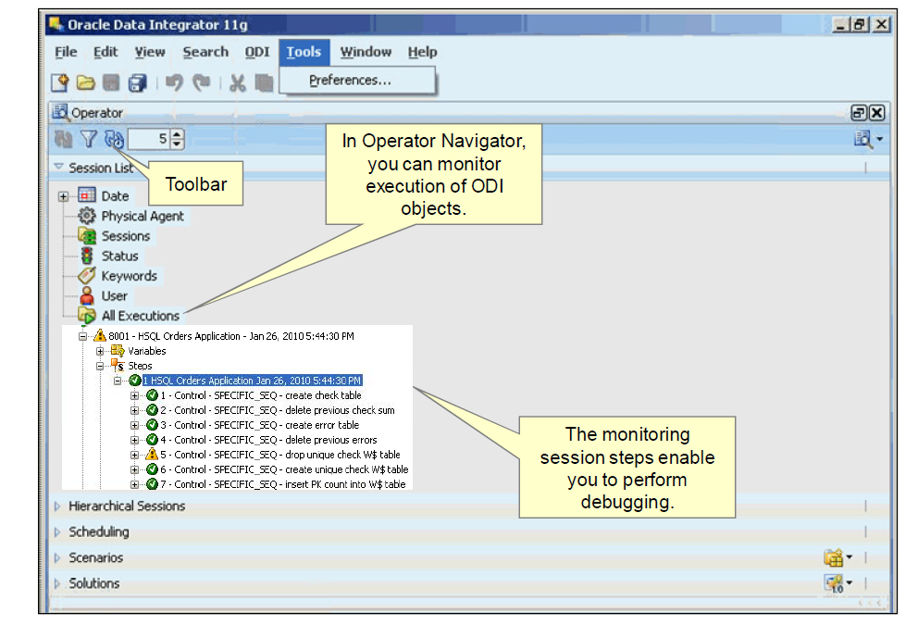
Operator Navigator

Slide 13
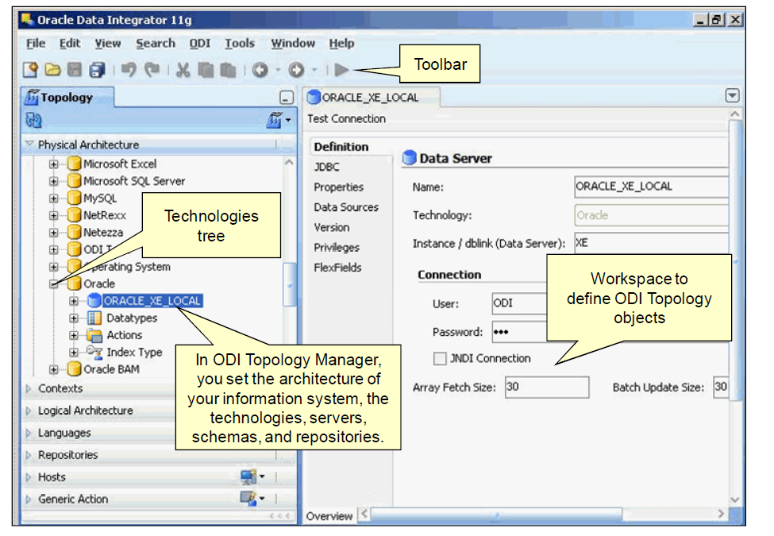
Topology Navigator

Slide 14
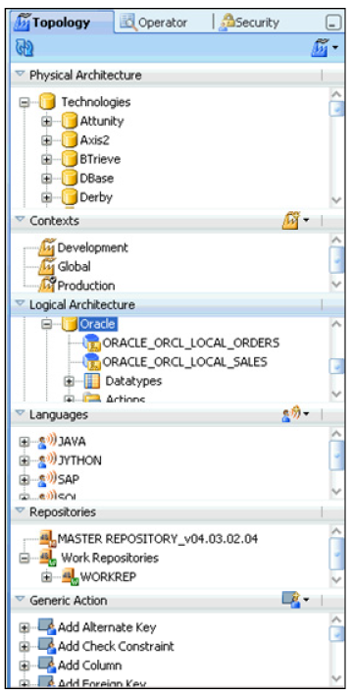
Topology Components
Physical architecture
Contexts: mapping logical to physical
Logical architecture
Languages
Repositories
Generic Actions

Slide 15
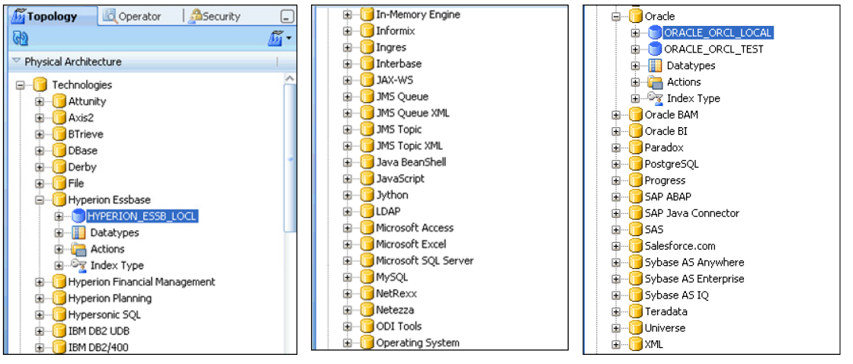
What is a Data Server?
A data server is any system capable of storing data and making it available in the form of tables.
A data server is always attached to a specific technology.

Slide 16
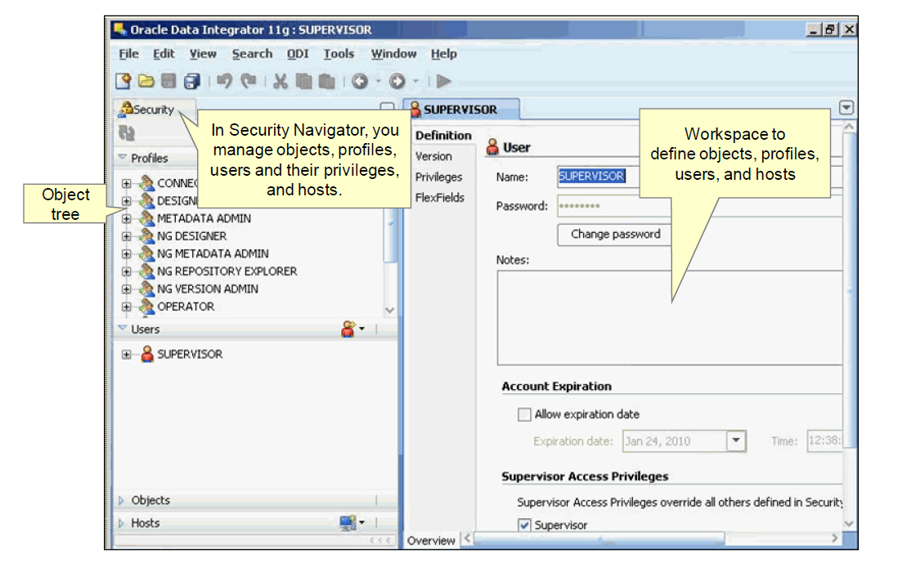
Security Navigator

Slide 17
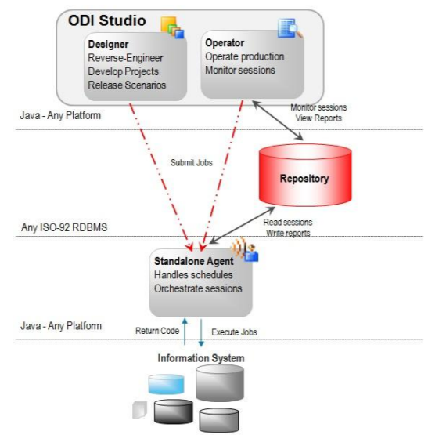
What is an Agent
An agent is a run-time component of ODI that orchestrates the integration process.
It is a lightweight Java program that retrieves code from the repository at run time.
At design time, developers generate scenarios from the business rules that they have designed. The code of these scenarios is then retrieved from the repository by the agent at run time.
This agent then connects to the data servers and orchestrates the code execution on these servers.

Slide 18
What is a context?
A context is an ODI object you define that represents a “situation” where a similar group of resources appears.
A context maps logical resources onto their implementations as physical resources (logical architecture onto a physical architecture).
In a given context, one logical resource is mapped to one unique physical resource.
Example of contexts:
– Sites: Boston, Tokyo, and Development
– Environments: Development, Test, and Production

Slide 19


